Slide 1


Neural Networks and Deep Learning for Life Sciences and Health Applications
An introductory course about theoretical fundamentals, case studies and implementations in python and tensorflow

Slide 2

Let’s start
Who am I
Who are you (background, profile, previous experience, expectations)
How is this course is structured

Slide 3

I studied Theoretical Physics in Italy, USA and Germany
Studied higher education and pedagogy in UK
Did several years of research in several countries on numerical simulations on superconductors materials
Worked several years in various industries
Focus now on machine learning and data science
I publish regularly on several peer reviewd journals and give talks at conferences
Love trail running and climbing

Slide 4

Who are you and what are your expectations

Slide 5
Day Structure
17:15 – 18:00 – Theory part
18:00 – 18:45 – Hands-on part
18:45 – 19:30 – Theory
19:30 – 20:00 – Hands-on part
20:00 – 20:10 – Conclusion

Slide 6
Methodology / Theory
Technical / Programming / Tools

Slide 7

Every Tuesday 17:15-20:00 – Please arrive at 17:00 so that we can start on time
Exact dates:
23.10 – Preparation course: Python and numpy with Linear Algebra 30.10 - Preparation course: Data Analysis & Calculus 6.11 13.11 20.11 27.11 4.12 11.12 Christmas Pause 15.1 22.1 (End Project) 29.1 (End Project) 5.2 (End Project)

Slide 8

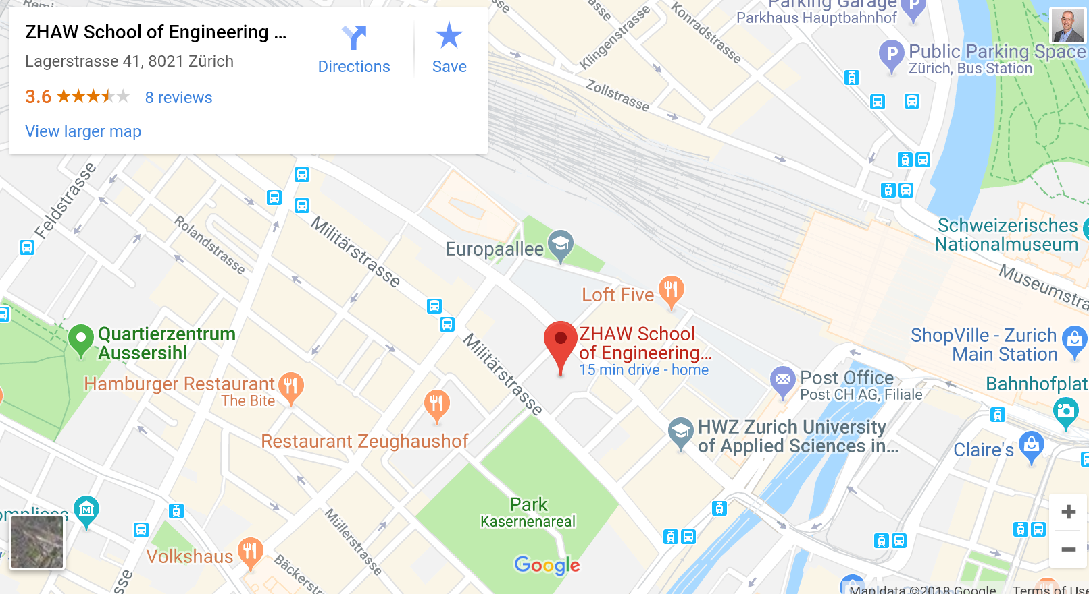
Location / Venue
We meet every Tuesday here
ZHAW Zürcher Hochschule für Angewandte Wissenschaften Lagerstrasse 41 8021 Zürich
Room: room ZL 03.09

Slide 9

Feel free to contact me anytime at umberto.michelucci@gmail.com with any kind of questions. I will answer each and every email I will receive.
If is really urgent you can get in touch with me by phone: 079 396 7406. You can find me also on whatsapp.

Slide 10

You will find everything on github at this link
https://github.com/michelucci/dlcourse2018_students
(or if you want to type it https://goo.gl/CgDbUH)
On github you will find all power point presentations, all jupyter notebooks and all datasets that we will use during this course.
UPLOAD YOUR LOCAL COPY EVERY MONDAY. I WILL UPDATE IT REGULARLY.

Slide 11








In this course we will use:
Files management system: github.com
Programming language: python (anaconda distribution: https://conda.io/docs/user-guide/install/download.html)
Development environment: Jupyter notebooks
Python packages: numpy / matplotlib / (less frequently) pandas
Python deep learning package: tensorflow
Your brain

Slide 12
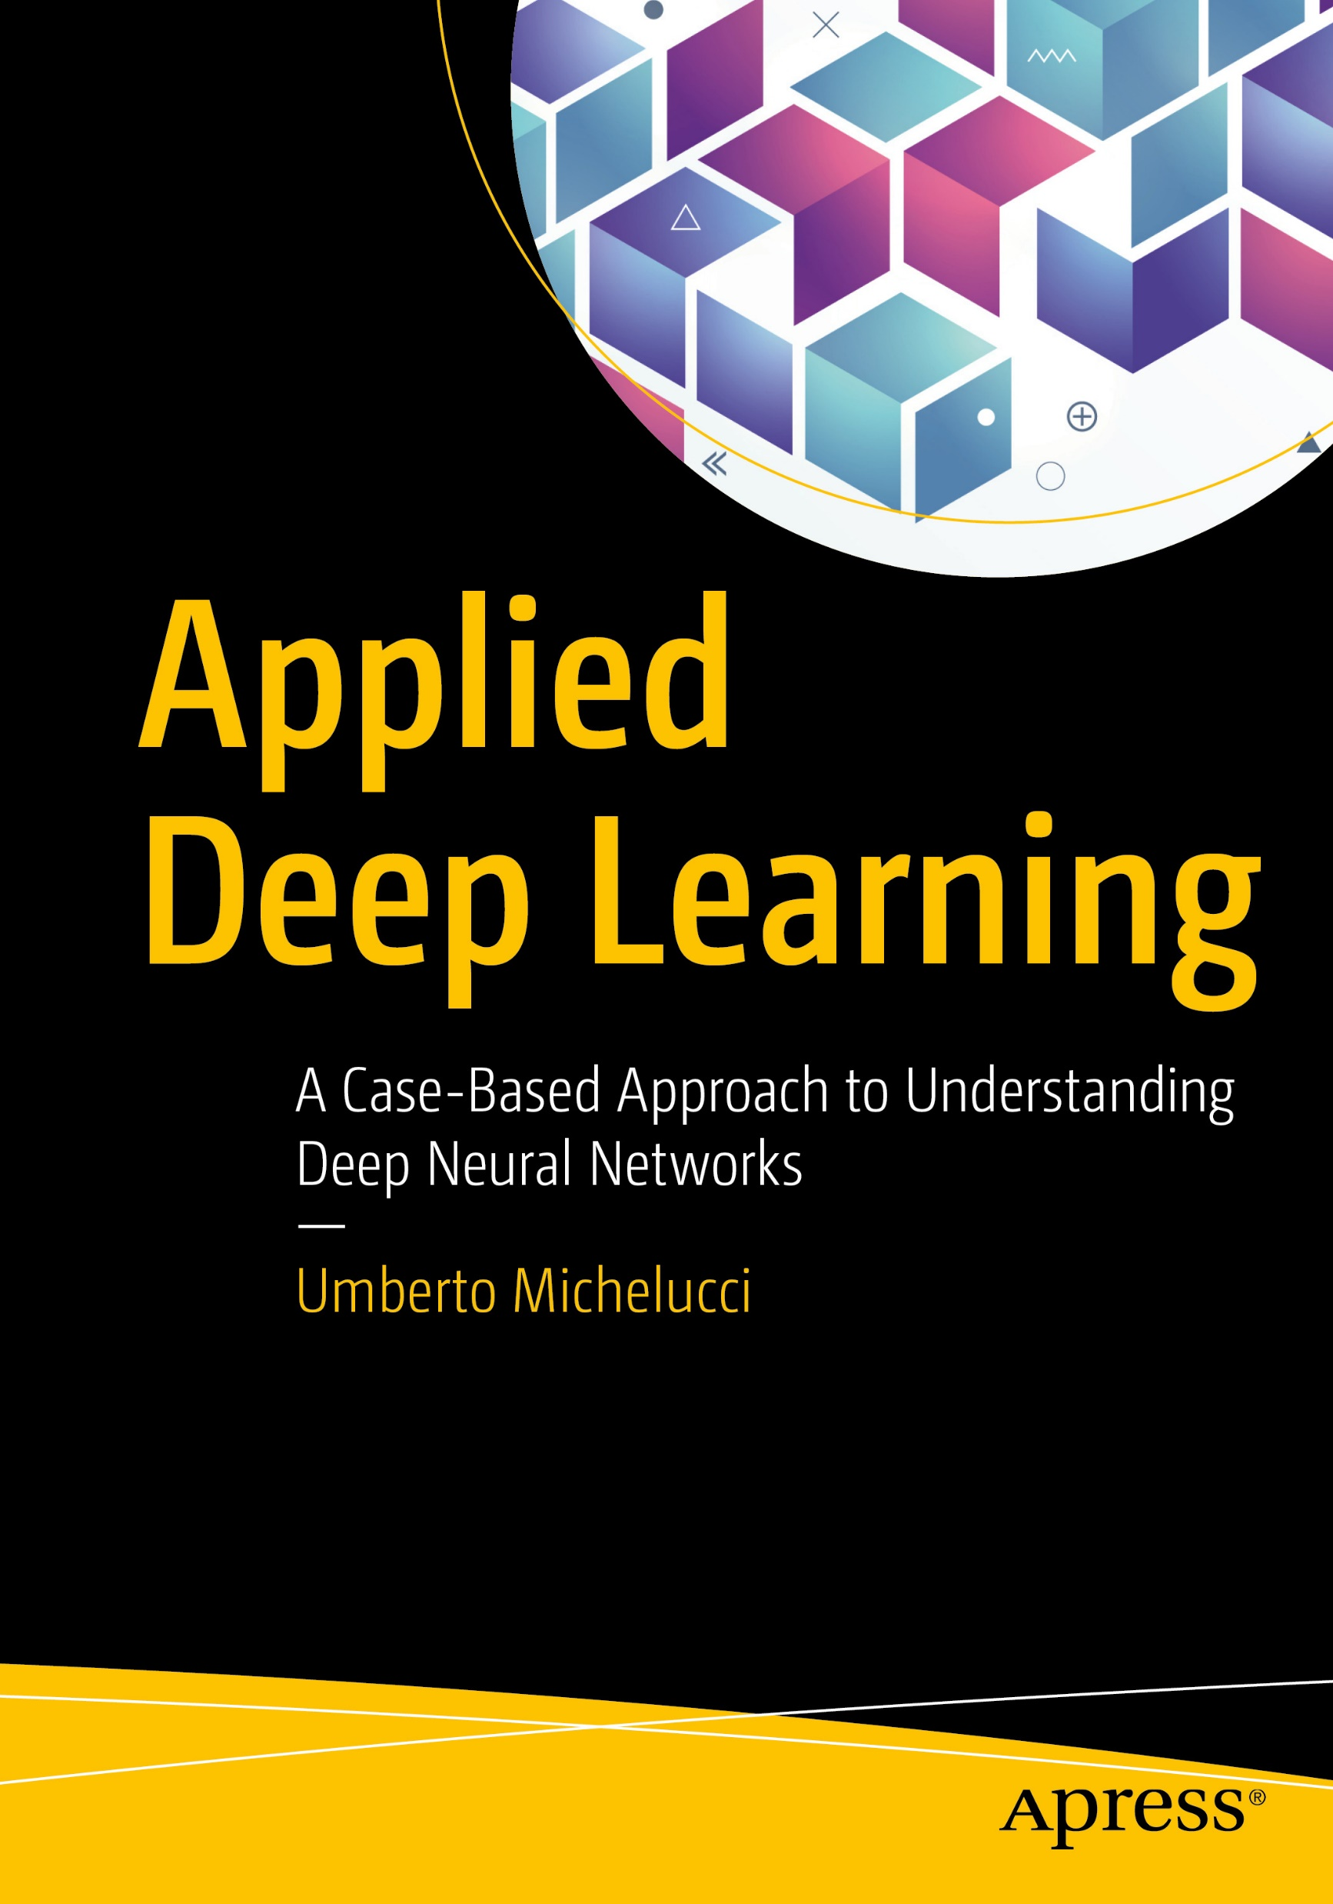
We will follow the book during the course
I will try to follow one chapter every week
Book PDF Download: https://goo.gl/CgDbUH (under the folder «book»)

Slide 13
How to setup your environment
Check Chapter 1 of book to see how to setup your development environment. In case you need help let me know by email or in person.

Slide 14
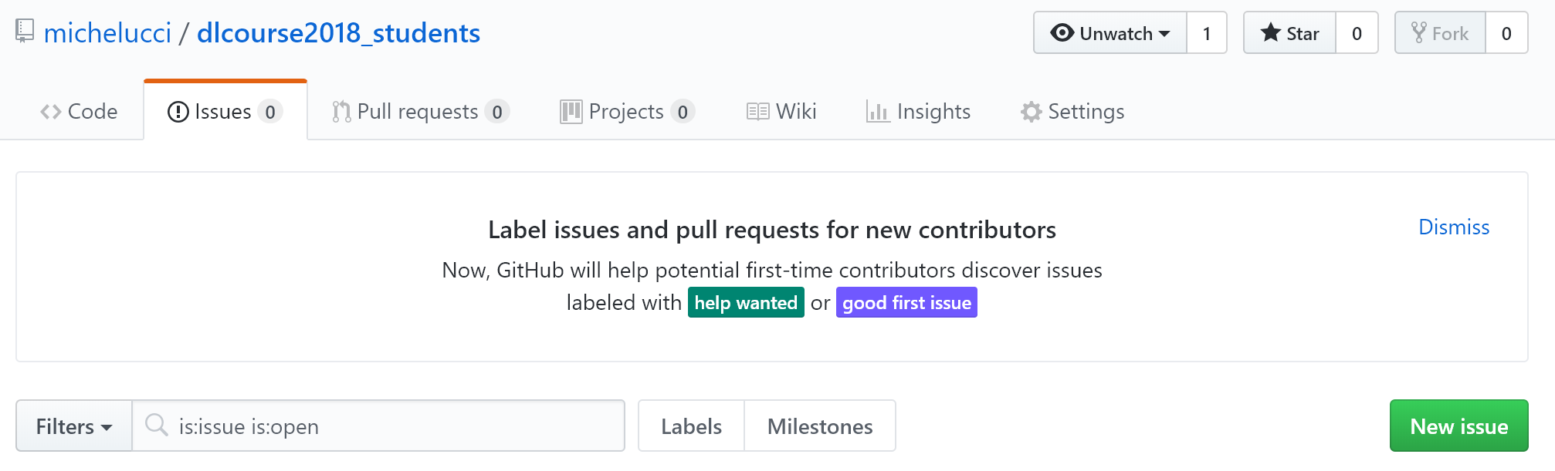
How to send me errors and requests
I am not perfect so the probability that you will find errors in the powerpoint presentations or (especially) in the code examples (the jupyter notebooks) is not zero. In case you do, please send me the bugs. To make the bugs easier to correct (for me) and easier to check (for you) please use the «New Issue» functionality in github (see following slides to see how)

Slide 15
How to create an issue in github
To learn how to create a bug in github you can follow this easy guide from github
https://help.github.com/articles/creating-an-issue/
(or if you want to type https://goo.gl/294qg4)

